Slide 1

Hotel Bookings & Cancellations
Group 3:
Estelle Wong
Nihal Kala
Pavan Manoj
Harsha Pavuluri

Slide 2
Project Goals
Predictive model to predict booking cancellations → aim for a low rate of false positives
Analyze trends of booking demand, average daily rates, and cancellations

Slide 3
Societal and Business Impact
For Business: Identify opportunities, mitigate potential loss in revenue
For Consumers: Understand factors that affect hotel prices, more strategic trip planning

Slide 4
Dataset
A resort hotel located in Algarve and a city hotel in Lisbon
Data collected over 3-year period

Slide 5
Exploratory Data Analysis
Booking demand
Average Daily Rates
Length of Stay
Cancellations

Slide 6
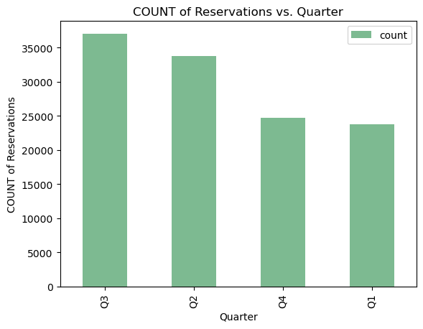
Distribution of Reservations
Highest number of reservations: City Hotel > Resort Hotel
Q3 > Q2 > Q4 > Q1

Slide 7
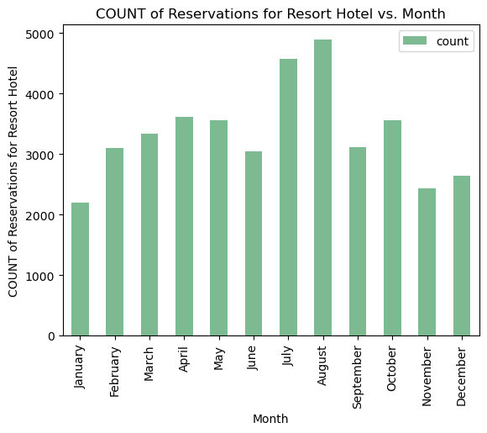
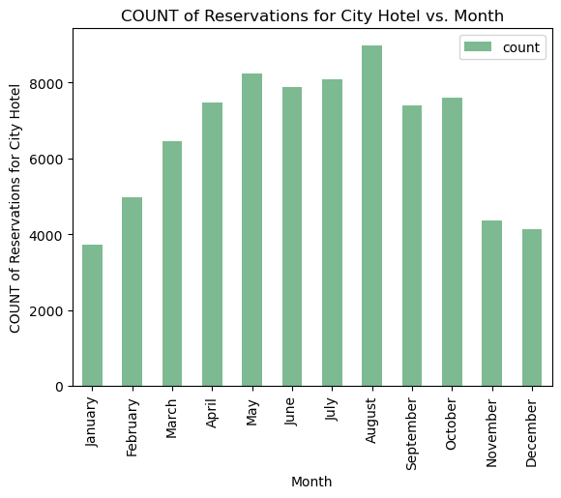
Peaks near Q2 and Q3
August: most number of reservations
December/January: least number of reservations
Distribution of Reservations

Slide 8
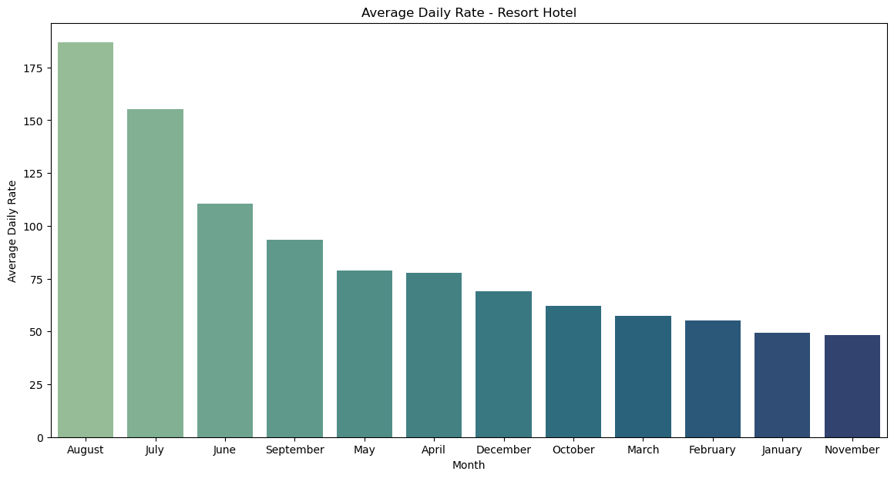
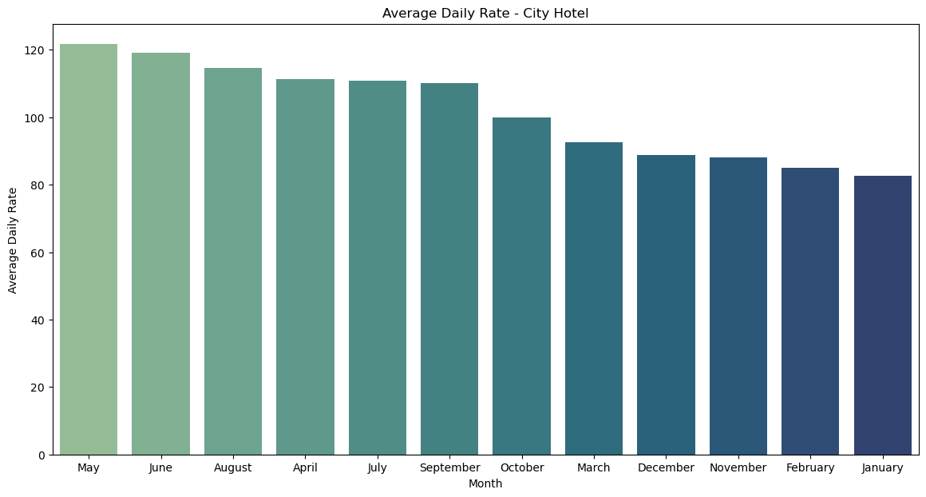
Higher ADR during the Summer months for both types of hotels
City Hotel prices tend to fluctuate less by season
Low Correlation between ADR and Month of Arrival
Average Daily Rate (ADR)
& Month of Arrival
Notes:
There are some interesting inferences, especially when we look between the hotel types. The Resort hotel has a steeper drop off in ADR especially going into the Fall/Winter months. For city, although the ADR is higher in the summer months and drops off, this drop off is less steep and the overall price is lower in the summer than the resort hotel

Slide 9
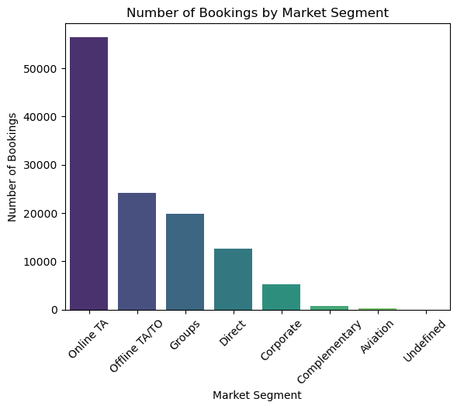
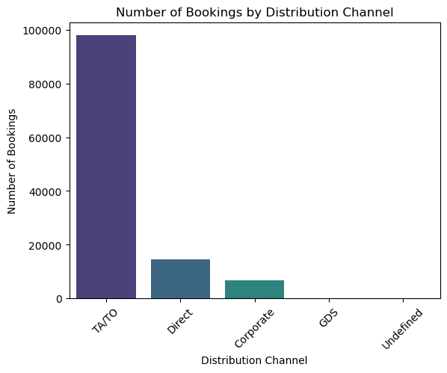
Online TA > Offline TA
Distribution Channel: Travel Agent/Tour Operators (dominant)
Limited direct and corporate distribution channels
Market Segment and Distribution Channel

Slide 10
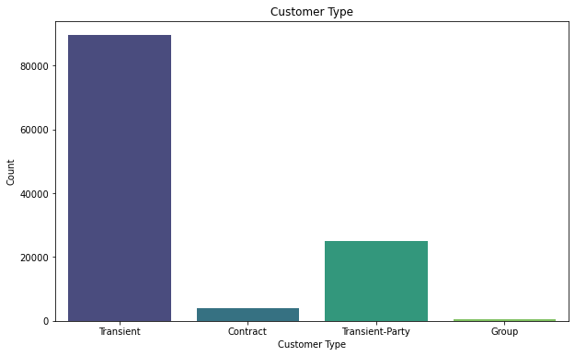
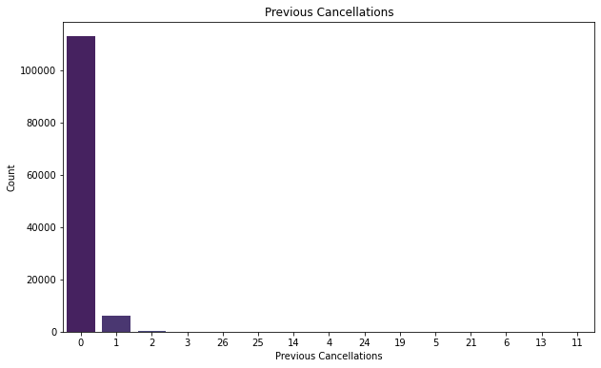
Dataset was mainly based in Europe
Majority Customer Type: Transient
Most customers have 0 previous cancellations
Customer Type and Previous Cancellations

Slide 11
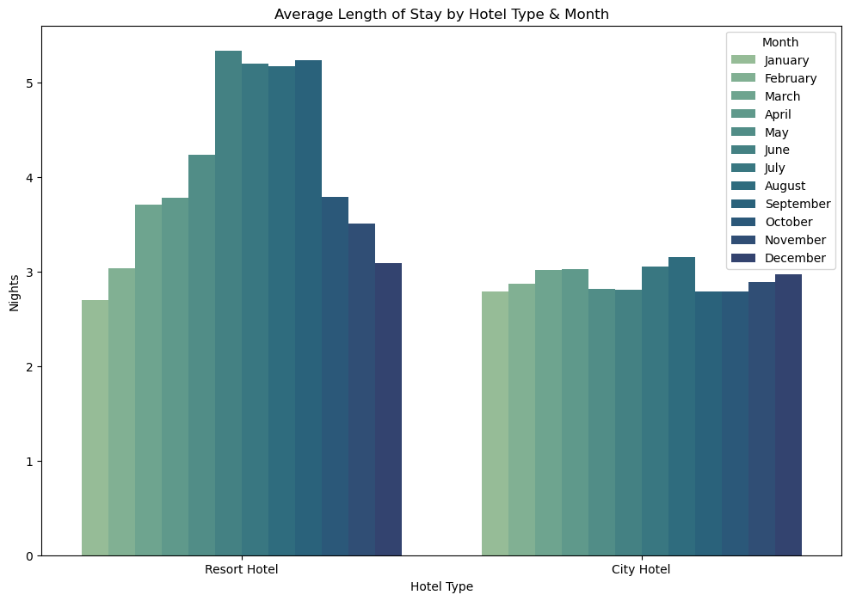
Length of Stay &
Time of Year
Average duration of stay: Resort hotel > City hotel
Resort Hotel: June through September
City Hotel: ~ 3 nights

Slide 12
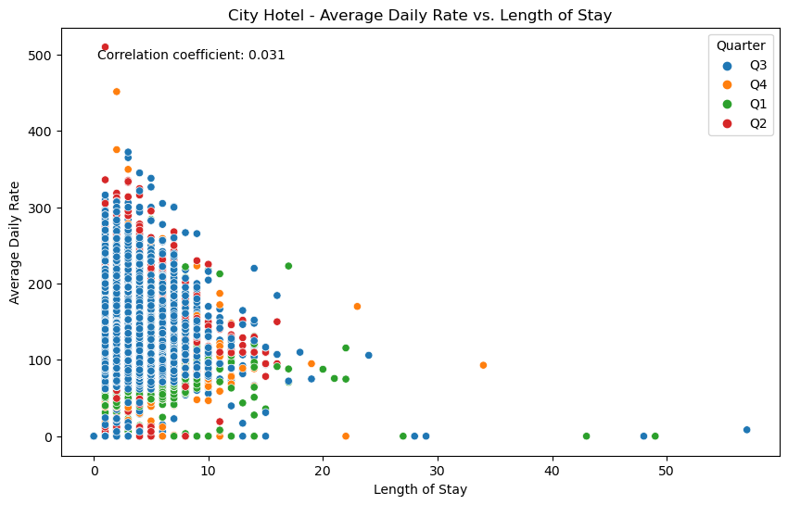
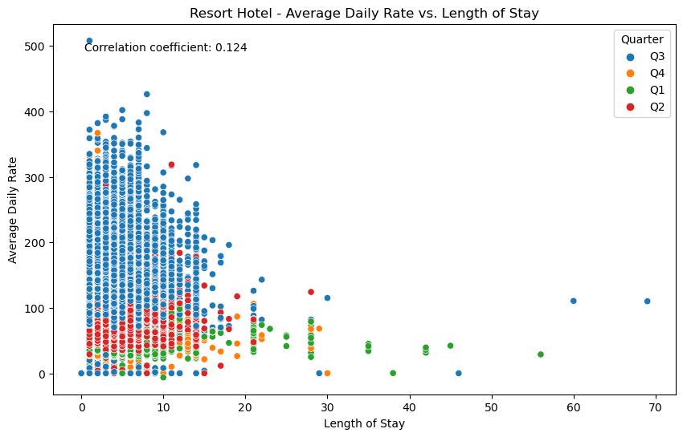
Low correlation between ADR and Length of stay
Q1 and Q2 show lower range of ADR
Q3 has wider range but mostly higher than other quarters
Average Daily Rate
& Length of Stay
Notes:
There is a weak correlation between the length of stay and the average daily rate, indicating that staying longer does not necessarily result in a lower rate.
The third quarter (Q3) exhibits the widest range of average daily rates, with rates in other quarters generally being lower.
This trend aligns with the highest number of bookings occurring in July and August, allowing hotels to increase room prices according to demand. And despite the weak correlation, most bookings in the first (Q1) and second quarters (Q2) generally have lower rates compared to Q3, especially for the resort hotel.

Slide 13
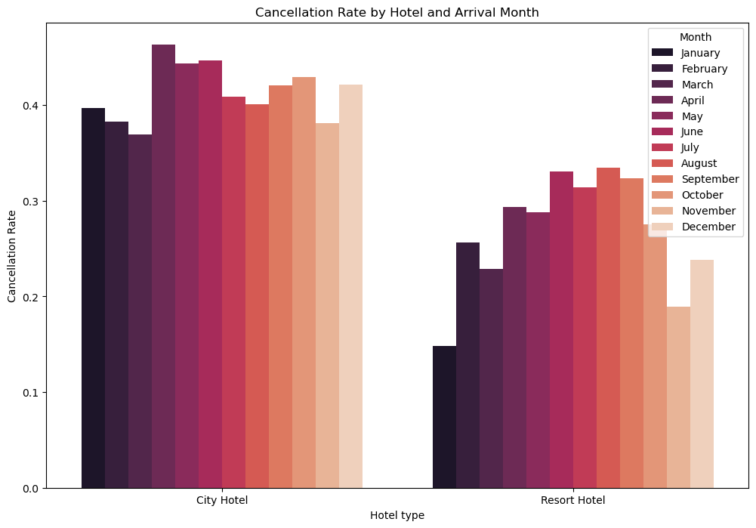
Cancellation Rate by Month
City hotel → highest cancellation rates between April and June, as high as 44.7%
Resort hotel → highest cancellation rate between June and September, ranging 31%-33%
Notes:
The city hotel experiences its highest cancellation rates between April and June, reaching up to 44.7%.
The resort hotel generally has lower cancellation rates. Its peak cancellation period occurs between June and September, with rates ranging from 31% to 33%.

Slide 14
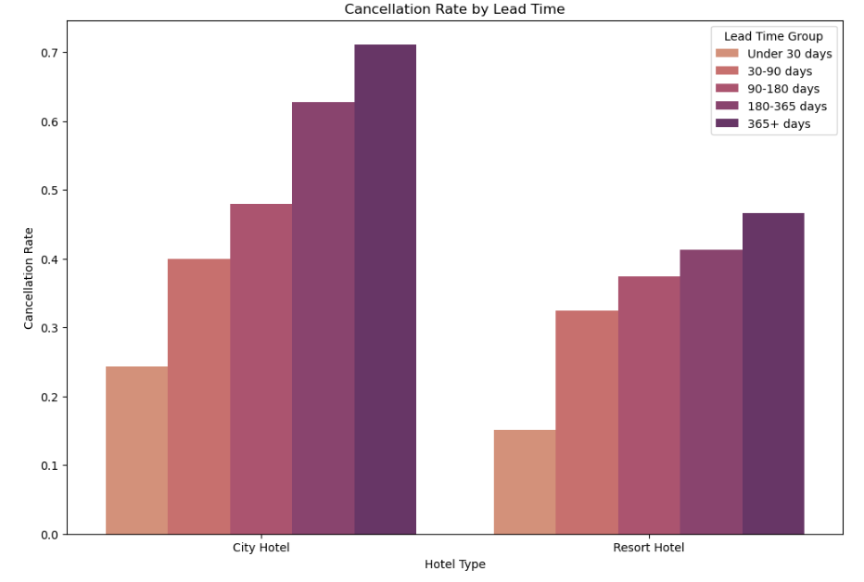
Cancellation Rate by Lead Time
City Hotel and Resort Hotel share similar trend
Longer lead time → higher cancellation rate

Slide 15
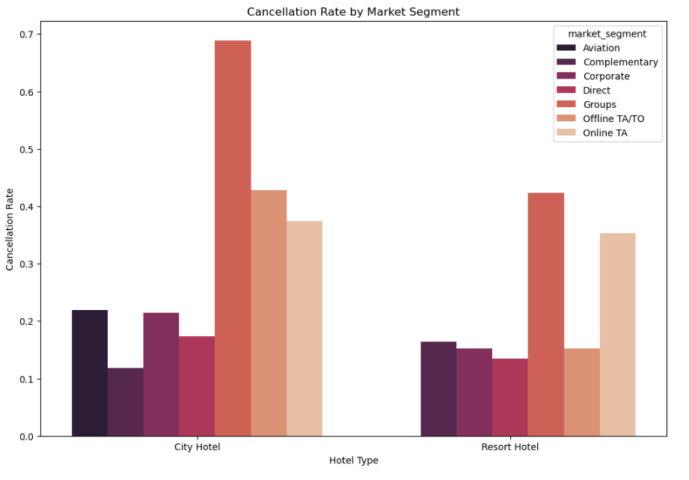
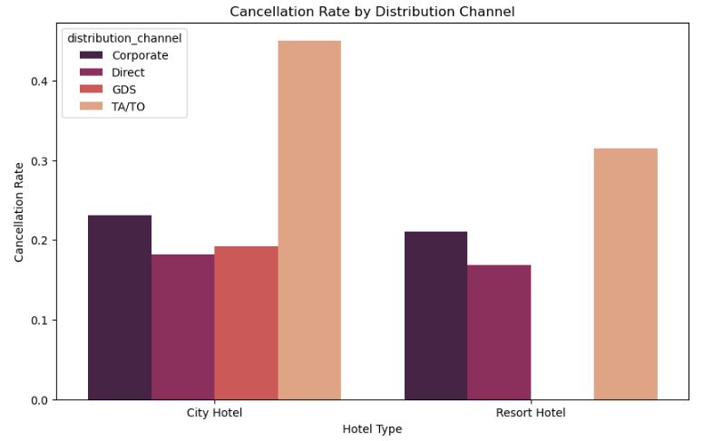
Cancellation Rate by Market Segment & Distribution Channel
Groups, online travel agencies → high cancellation rates

Slide 16
Features
Deposit type
Lead time
Country
Days in waiting list
Customer type
Distribution channel
Previous cancellations

Slide 17
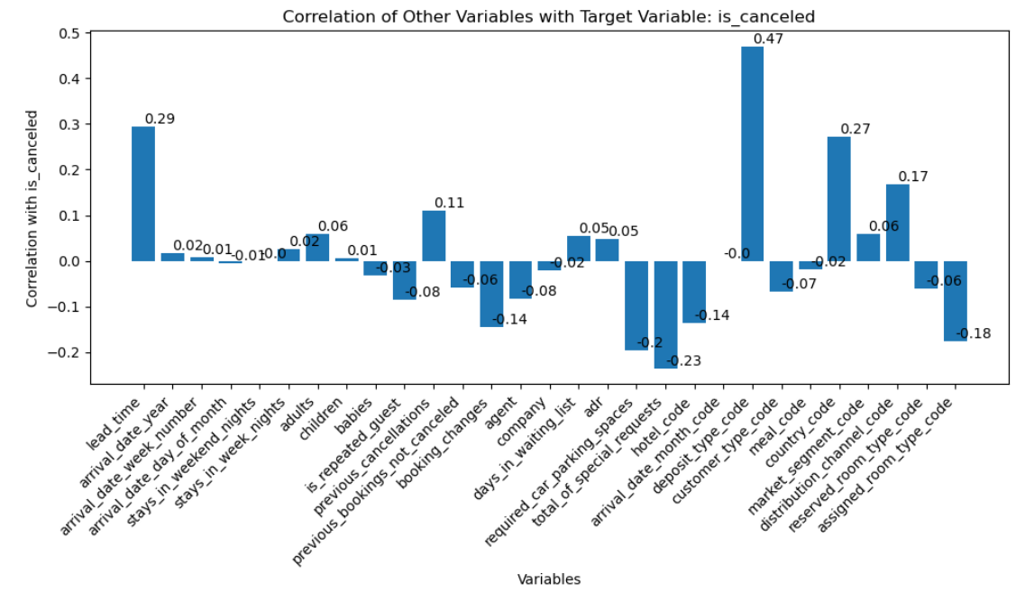

Slide 18
Model Building
Logistics Regression
Bagging Classifier
Gradient Boosting Classifier
Decision Tree Classifier
Random Forest Classifier

Slide 19
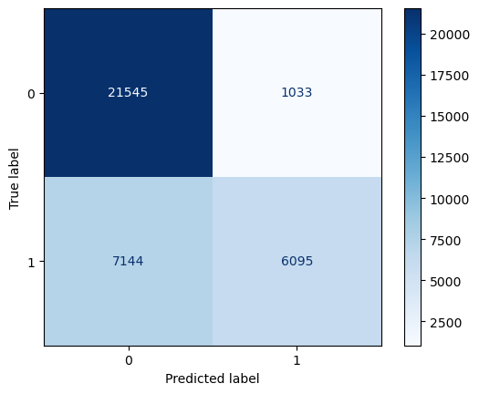
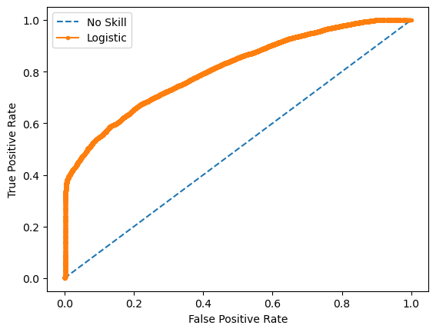
Accuracy (Correct Predictions): 77.17%
F1 Score (Precision & Recall): 72%
Precision Score (Correct Positive Predictions): 80%
Recall Score (True Positive Rate): 71%
Logistics Regression (10 features used)

Slide 20
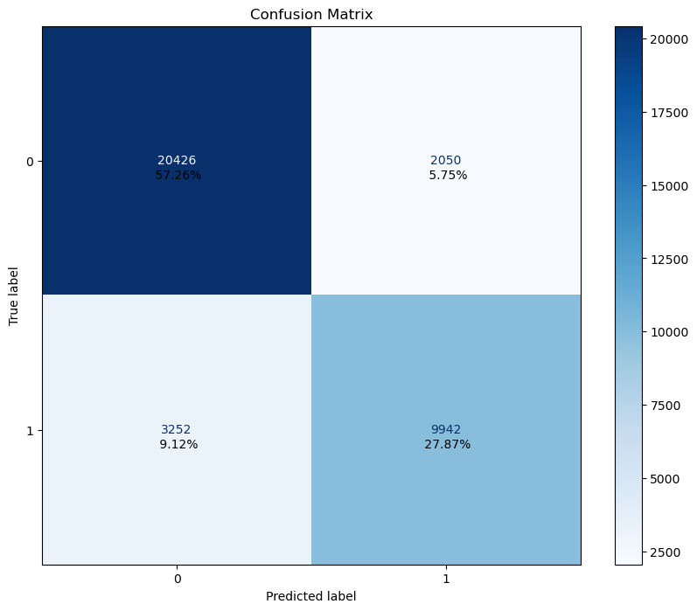
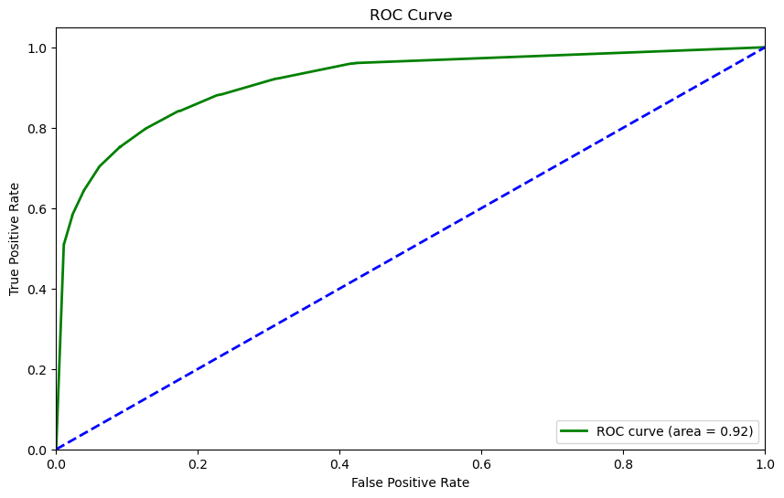
Accuracy (Correct Predictions): 85.13%
F1 Score (Precision & Recall): 78.95%
Precision Score (Correct Positive Predictions): 82.91%
Recall Score (True Positive Rate): 75.35%
Bagging Classifier (11 features used)

Slide 21
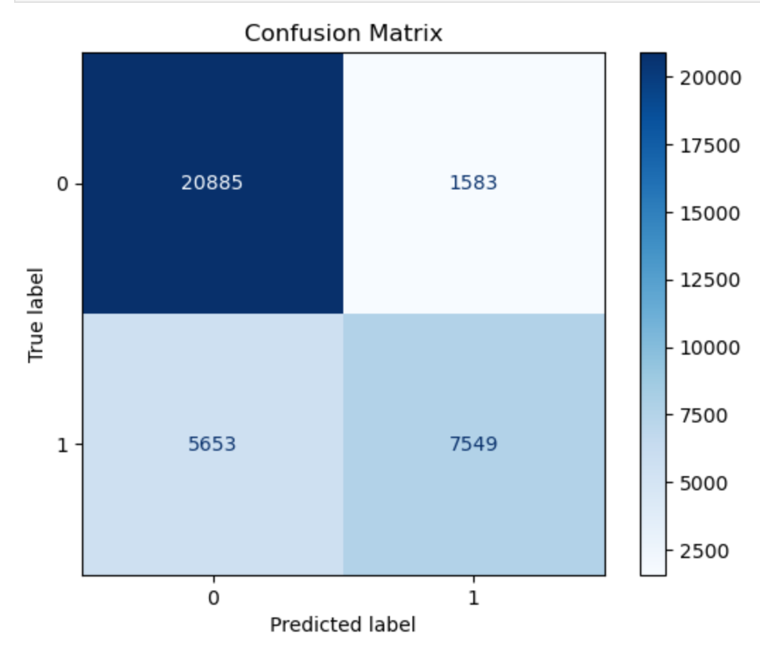
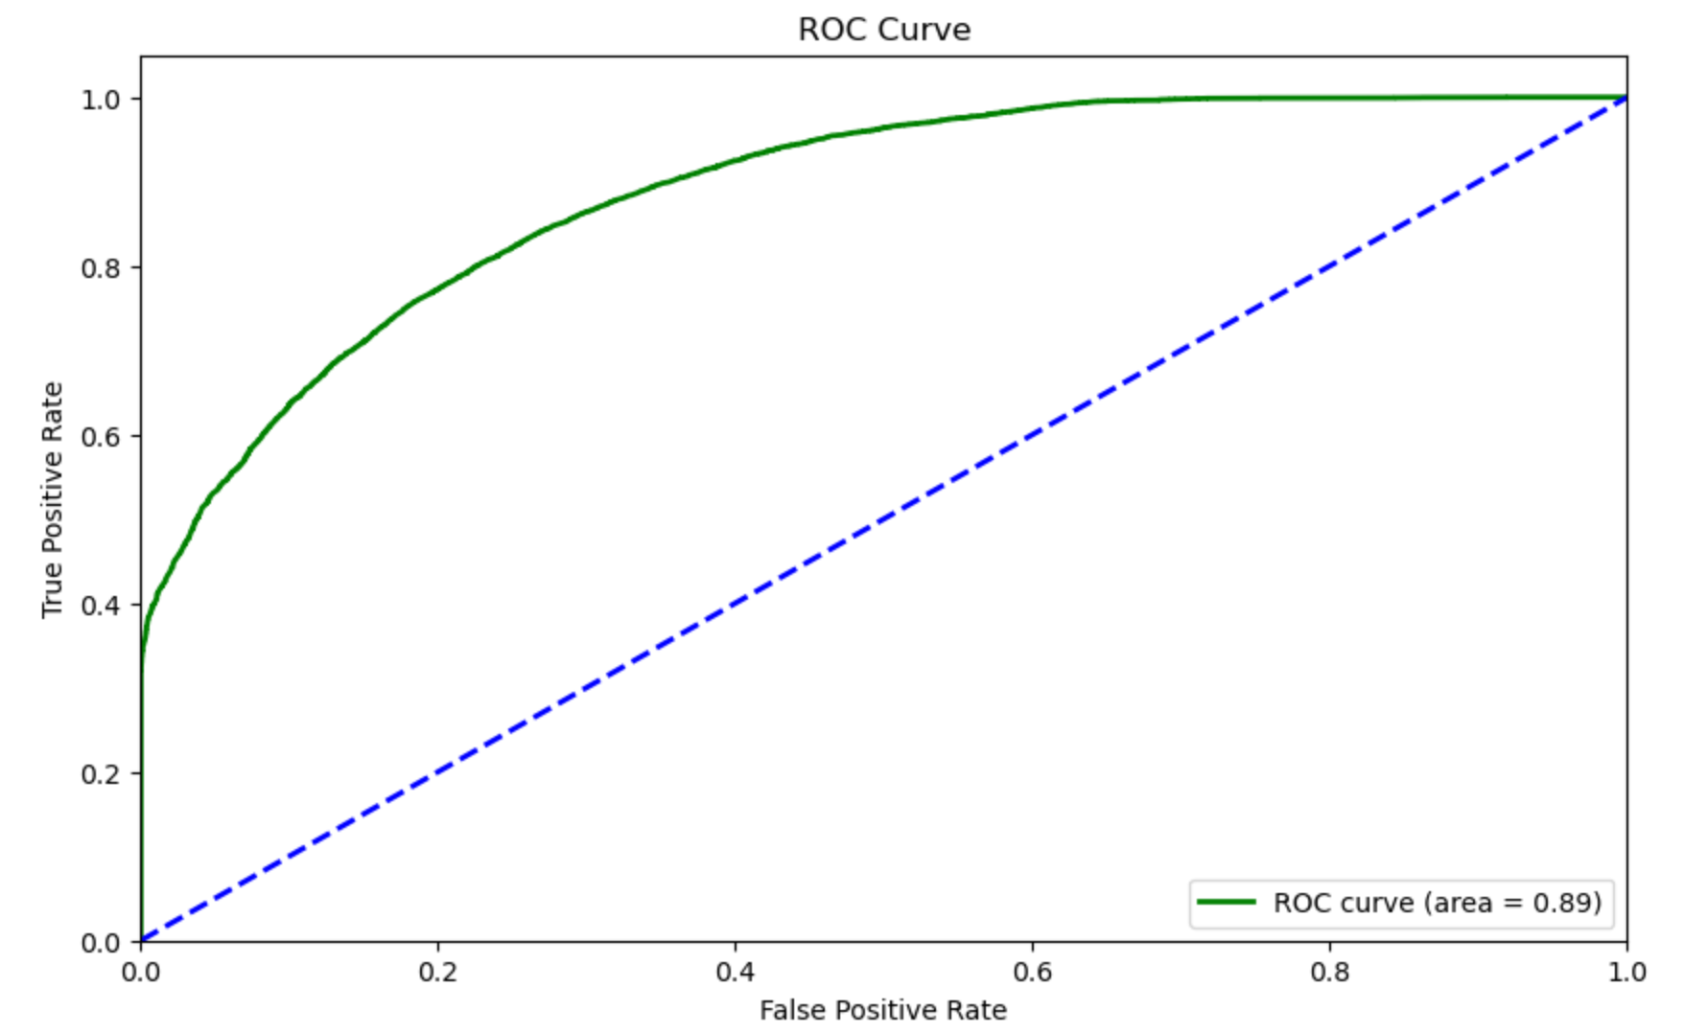
Training Accuracy: 80.00%
Test Accuracy: 79.24%
F1 Score (Precision & Recall): 66.63%
Precision Score (Correct Positive Predictions): 82.24%
Recall Score (True Positive Rate): 56.00%
Gradient Boosting Classifier (16 features used)

Slide 22
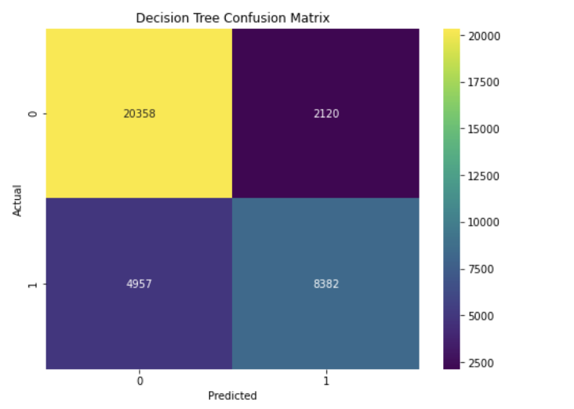
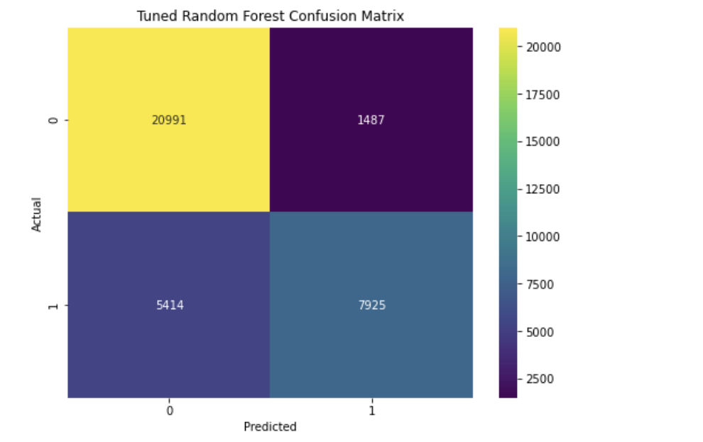
Testing Accuracy: 80.24%
Training Accuracy: 85.02%
F1 Score: 80%
Precision Score: 80%
Recall Score: 80%
Testing Accuracy: 80.73%
F1 Score: 80%
Precision Score: 81%
Recall Score: 81%
Decision Tree and Random Forest
Notes:
Nihal

Slide 23
Model Analysis
Most important features
Least important features
Most surprising features
General Inferences
Notes:
Nihal

Slide 24
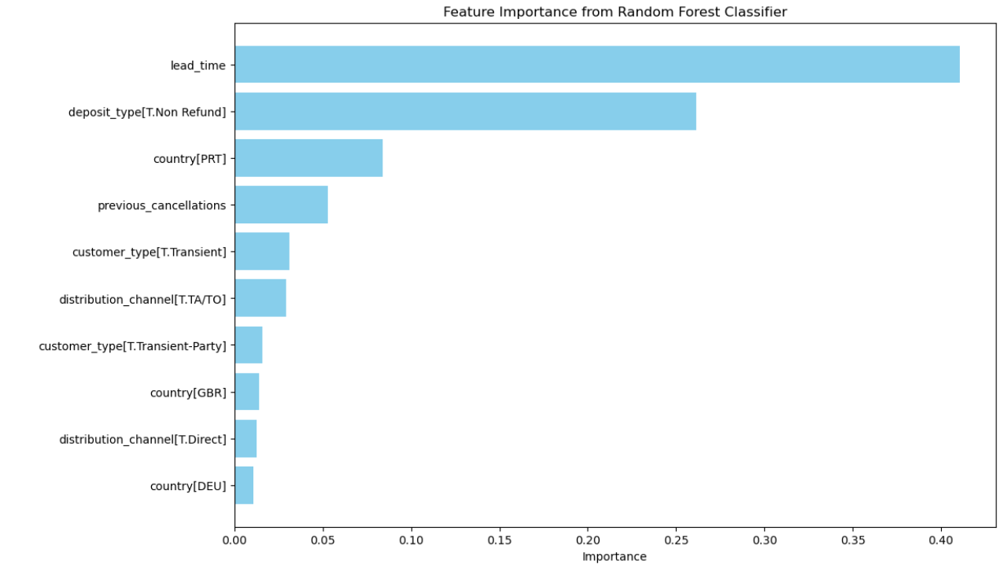
Notes:
Nihal

Slide 25
Insights
Market segment optimization
Overbooking allowance
Dynamic cancellation policy
Dynamic pricing by seasonality and/or lead time
Notes:
Harsha

Slide 26
Thank You!

